Slide 1
19CSE202 – DATABASE MANAGEMENT SYSTEM
Project : Music Database
TEAM :
Roll Number | Name
AM.EN.U4CSE22124 | G.UMESH
AM.EN.U4CSE22133 | LOUIS LARA
AM.EN.U4CSE22151 | S.RAVINDRA
AM.EN.U4CSE22164 | SACHIN KURUP

Slide 2
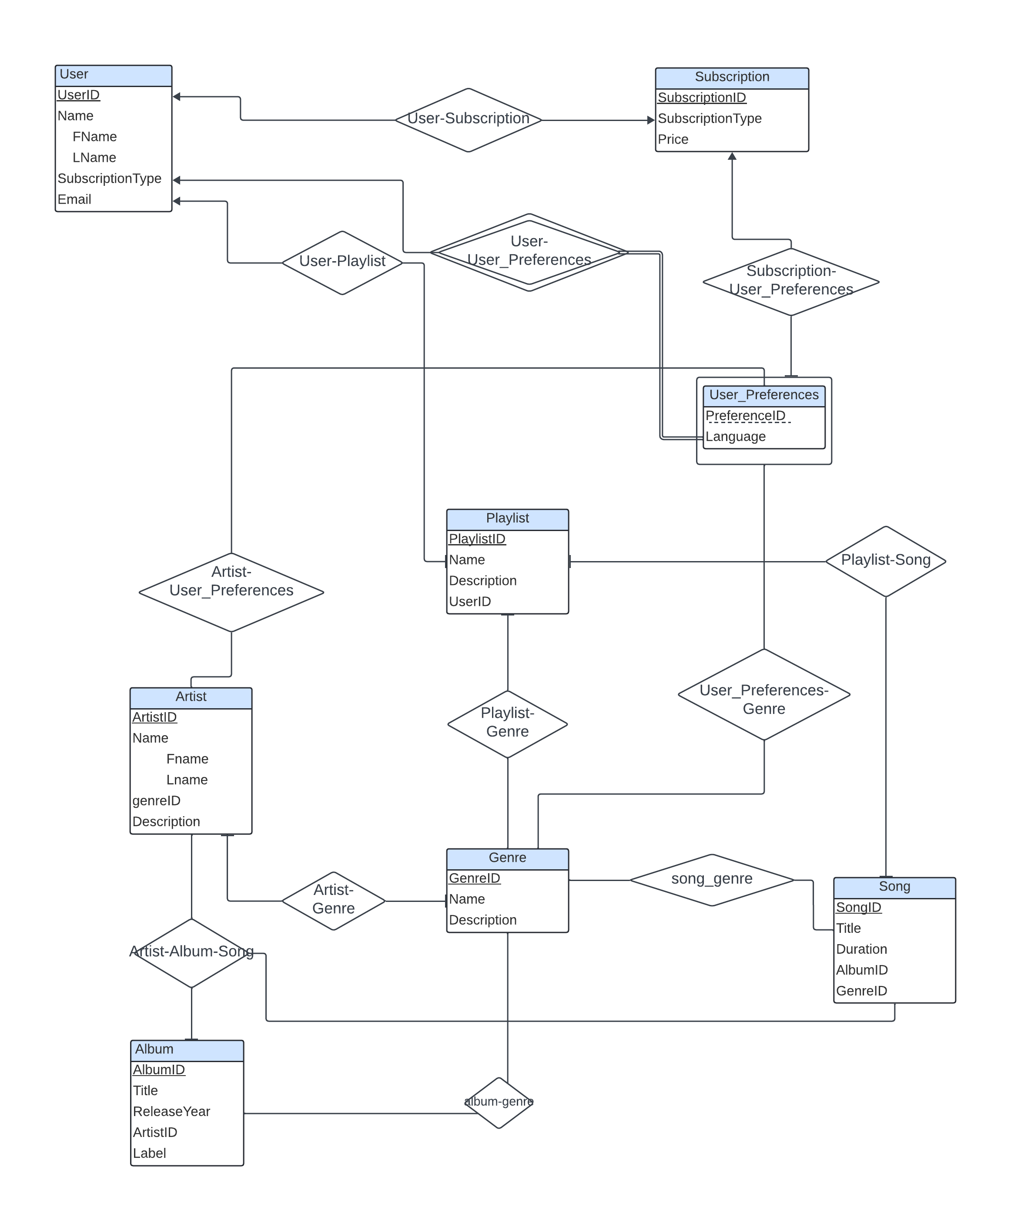
ER Diagram

Slide 3
Relational Schema
User( userId , name , email , subscriptionType)
User-Subscription(SubscriptionID (FK),UserID (FK))
Subscription(SubscriptionID, SubscriptionType,price)
User-Playlist(UserID (FK),playlistID (FK))
Playlist(PlaylistID,Name,Description,UserID (FK))
User_Preferences(PreferenceID , UserID (FK), Language)
Artist(ArtistID,Name,genreID,Description)
Artist-User_Preferences(ArtistID (FK),PreferencesID (FK))
User_Preferences-Genre(PreferencesID (FK),GenreID(FK))
Playlist-Genre(GenreID (FK),PlaylistID (FK))
Playlist-Song(SongID (FK),PlaylistID (FK)) Artist-Genre(ArtistID (FK),GenreID (FK))
Genre(GenreID,Name,Description)
Song(SongID,Title,Duration,AlbumID (FK),GenreID (FK),ArtistID (FK))
Artist-Album(ArtistID (FK),AlbumID (FK))
Song-Genre(SongID(FK),GenreID(FK))
Album(AlbumID,Title,ReleaseYear,ArtistID,Label)
Album-genre(AlbumID(FK),GenreID(FK))
Album_Artist_Song(ArtistID(FK),SongID (FK),AlbumID(FK))

Slide 4
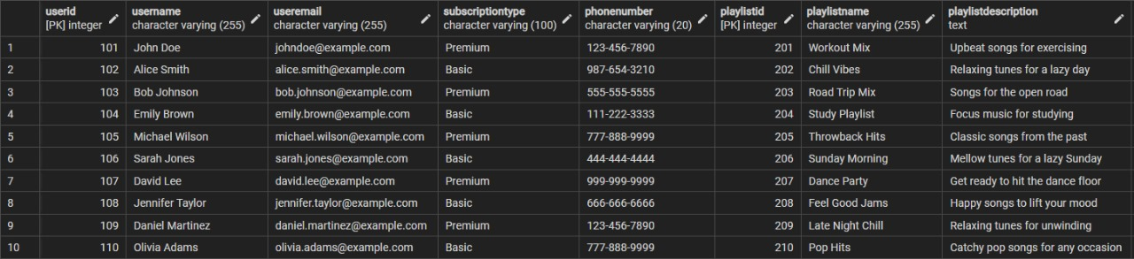
Universal Table

Slide 5
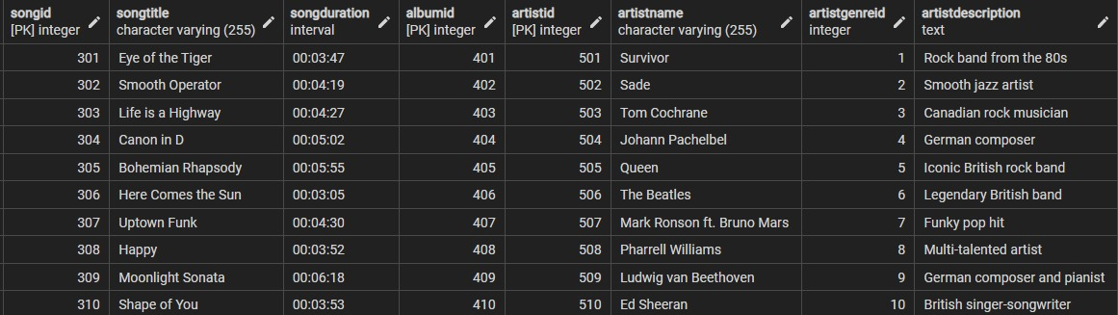
Universal table contd..

Slide 6
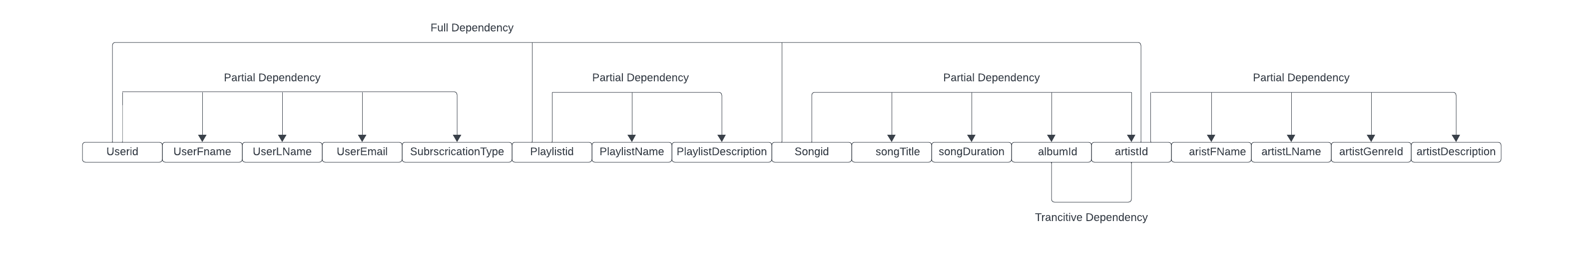
After creating Atomic Attributes (1NF)

Slide 7
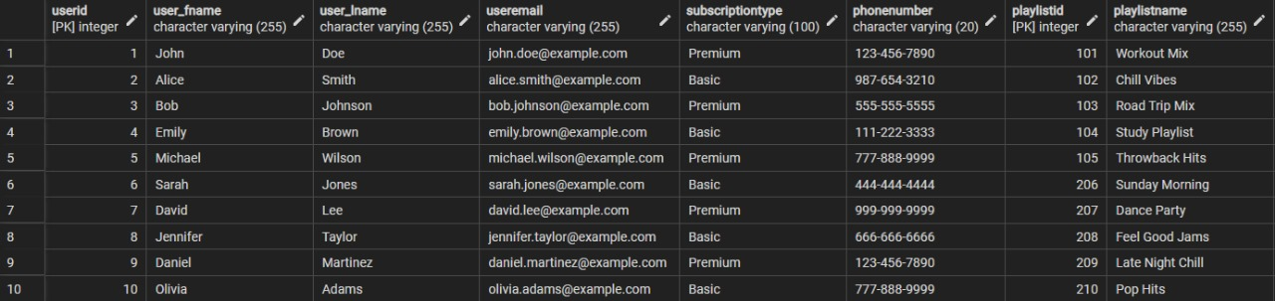
1NF
universal_1nf

Slide 8
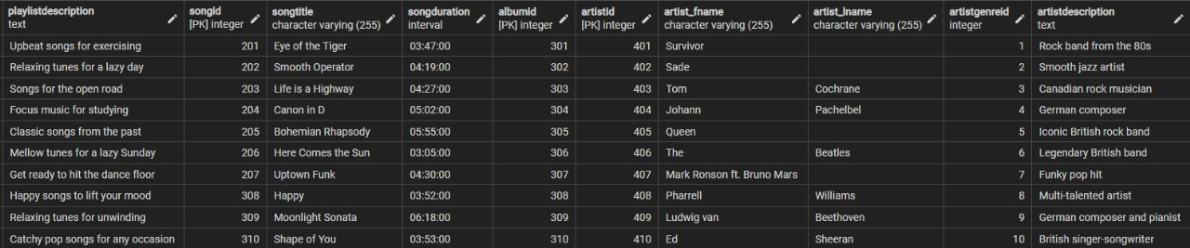
1NF

Slide 9
2NF

Slide 10
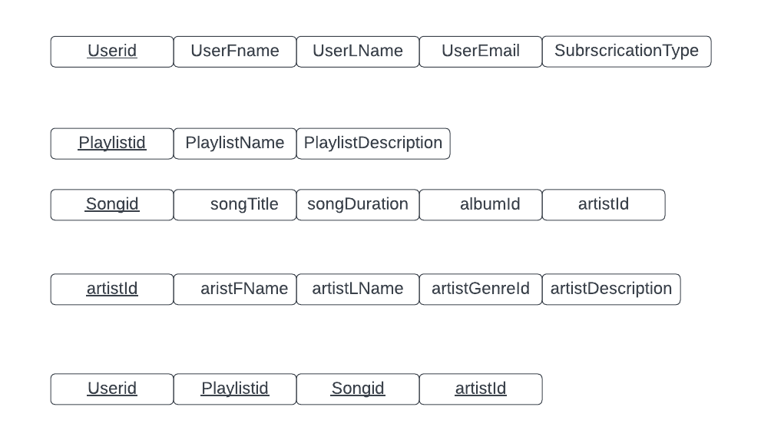
After Removing Partial Dependencies ( 2NF )

Slide 11
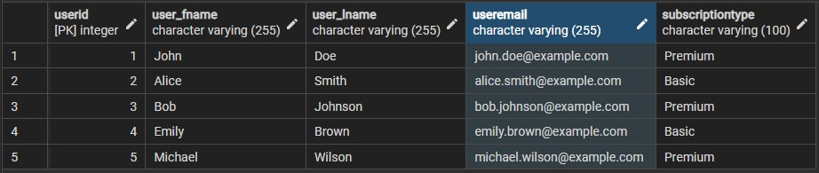
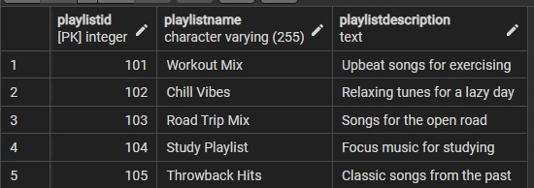
2NF
User_Details
Playlist

Slide 12
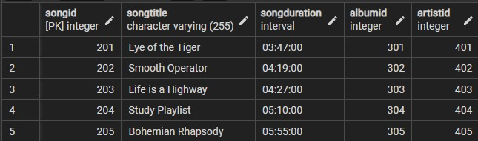
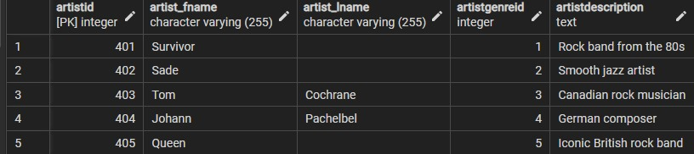
Song
Artist

Slide 13
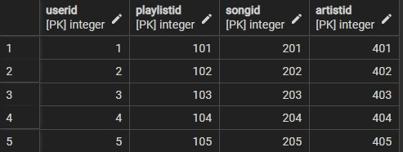
Universal Relation

Slide 14
3NF

Slide 15
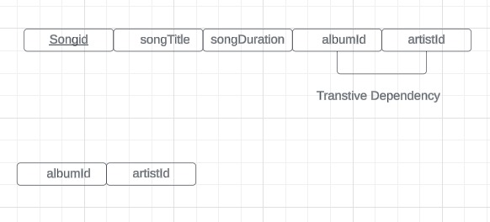
After Removing transitive Dependencies ( 3NF )

Slide 16
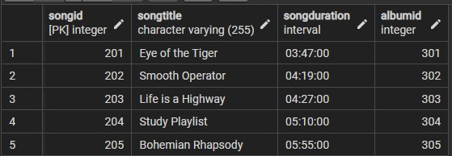
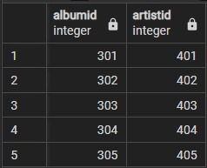
3NF
ThreeNFSong
Album

Slide 17
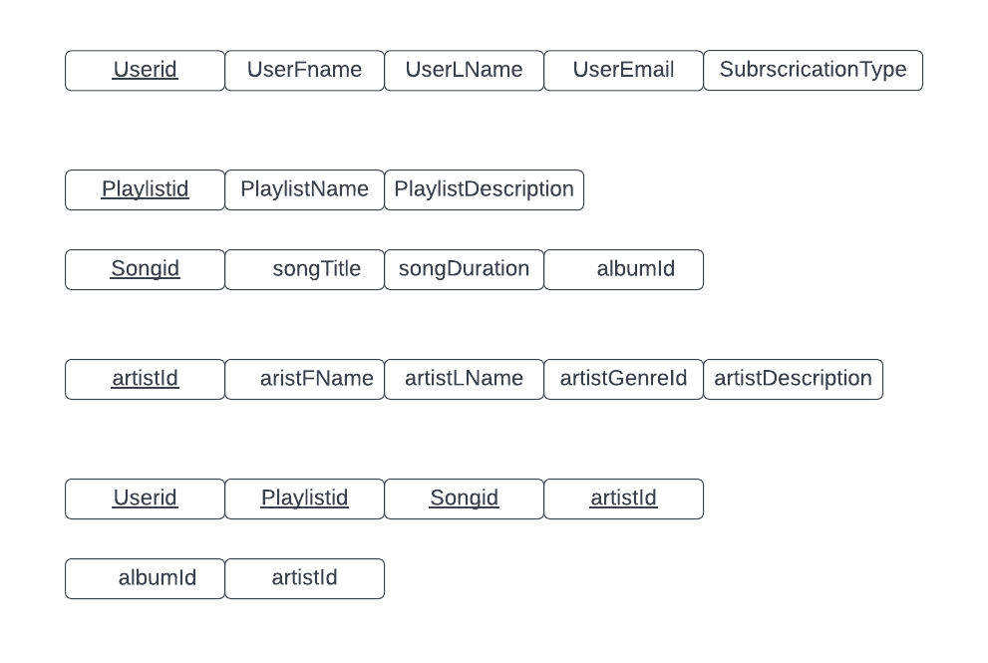
Final Relations with their Attributes

Slide 18
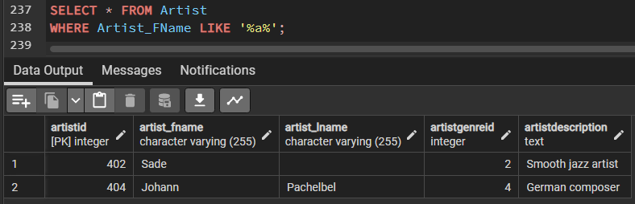
Query 1
This query will retrieve all artists whose first name contains the substring 'a'.

Slide 19
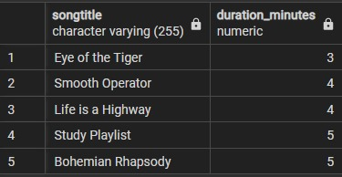
Query 2
This query extracts the minute part from the songDuration interval and displays it along with the song title.

Slide 20
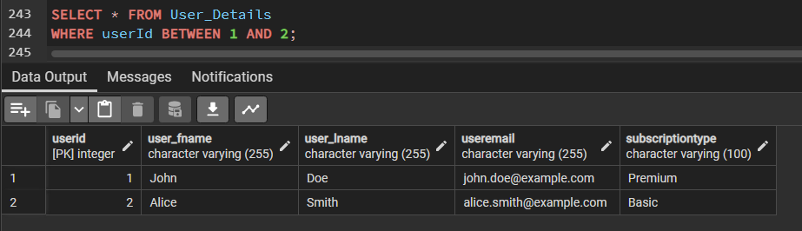
Query 3
These queries retrieve records based on whether the userId or artistId falls within or outside a specified range or set.

Slide 21
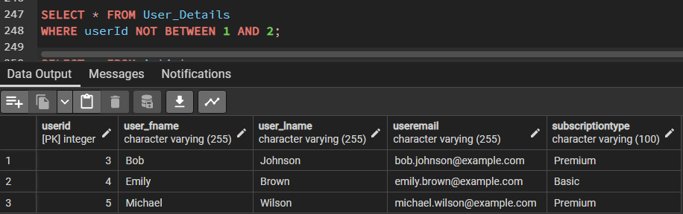
Query 4
These queries retrieve records based on whether the userId or artistId falls within or outside a specified range or set.​

Slide 22
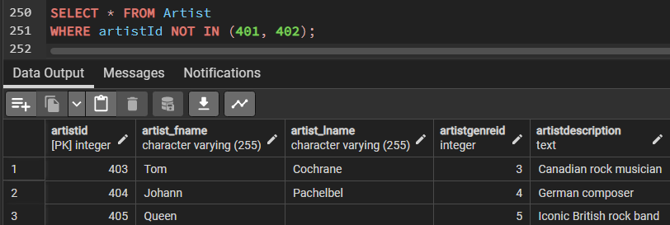
Query 5
These queries retrieve records based on whether the userId or artistId falls within or outside a specified range or set.

Slide 23
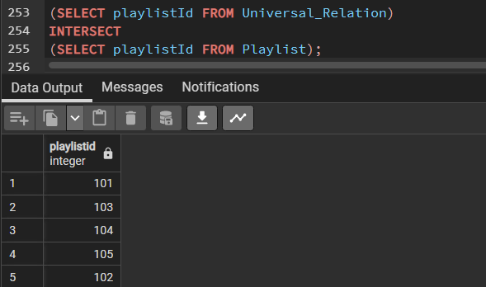
Query 6
This query will retrieve the playlistIds that exist in both the Universal_Relation table and the Playlist table.

Slide 24
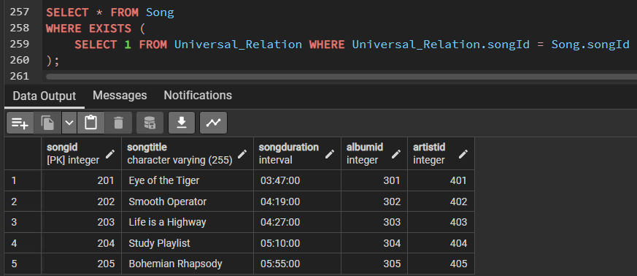
Query 7
These queries check for the existence or non-existence of related records in other tables using subqueries. This query retrieves songs that have entries in the Universal_Relation table

Slide 25
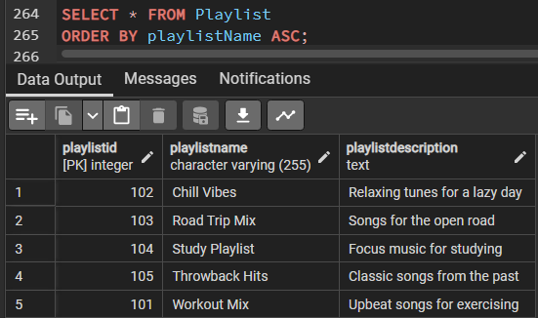
Query 8
This query retrieves all playlists from the database and sorts them alphabetically by playlist name in ascending order.

Slide 26
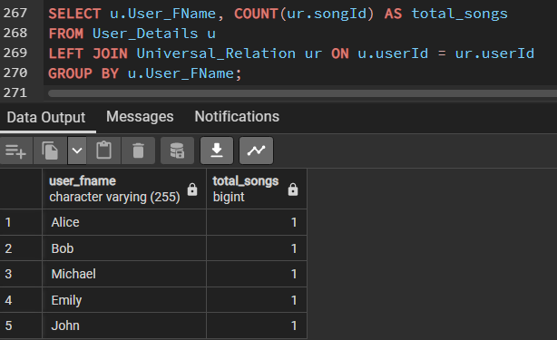
Query 9
This query retrieves the first name of users along with the count of songs they have in their playlists, including users who haven't added any songs to their playlists.

Slide 27
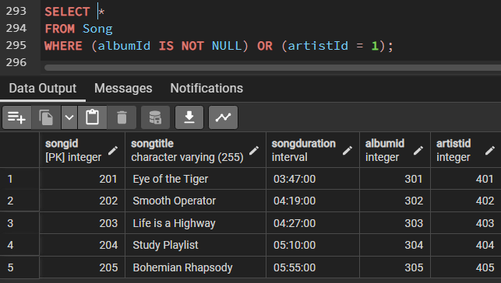
Query 10
Query having Boolean operators : This query retrieves all songs that either belong to an album (i.e., albumId is not null) or are by a specific artist (assuming artistId = 401)

Slide 28
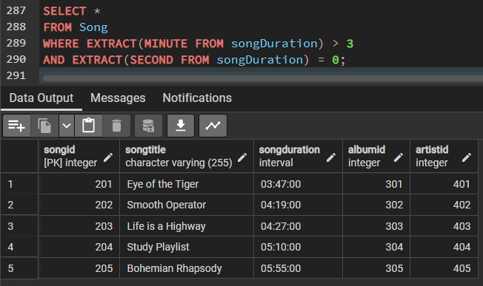
Query 11
Query having arithmetic operators: This query will retrieve all songs where the duration is less than 5 minutes.

Slide 29
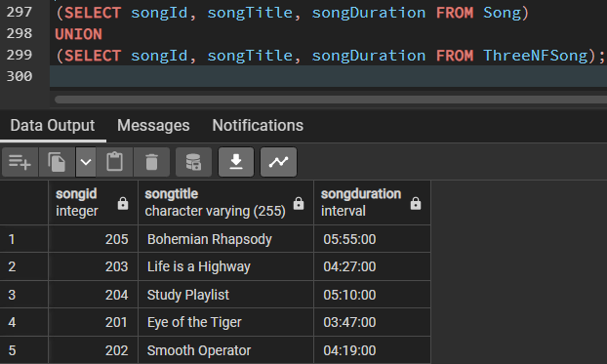
Query 12
Set operations: This query retrieves all songs from both the Song table and the ThreeNFSong table and combines them into a single result set, eliminating any duplicate rows.

